Slide 1

Alexander Trzcisnki-draper comp1004 project
Notes:
Hello for my project I have decided to develop a single page web application which displays images with information (could be an art piece, building or event) and educate or entertain the user. This will be done in HTML CSS and Javascript

Slide 2
Aims and objectives:
User-Generated Content: Permitting users to upload their own images fosters a sense of ownership and community contribution.
Engage Users with Interactive Content: Users can interact with images through likes, dislikes, and comments, enhancing user engagement.
Educational and Informative: By allowing information to be displayed alongside images, the application can serve educational purposes.
Community Building: Features like commenting and theme-based navigation encourage a community atmosphere around shared interest.
Notes:
I want to allow users to upload their own content so share with other people
Users will be able to interact with other user’s images by liking, disliking and commenting on their photos
I also want to add an education aspect by allowing the user to add information when uploading their images such as Historical photos or landmarks
By allowing users to comment I hope to create a community through this website

Slide 3
The website will
Allow the user to:
View the images on the website
View comments/information about an image
Add comments to photos
See the current like/dislike an image
The user will be able to like/dislike an image
Remove their like/dislike
Click on a navigation bar that holds different themes of photos (i.e History, Animals)
User will be able to select a category on the navigation bar that once pressed, will show photos that go under that category
Have a small window box where the user can upload their own image with the author or uploader name, information and what category
Notes:
So the user will be able to:
View all the images on the website
View the current comments and information about an image, also being able to add their own comments
They will be able to like and dislike an image also seeing the current amount
Navigate through the page via the navigation bar which one pressed will show images catalogued under that theme.
There will also be a small window where they can upload their own image having a choice to also adding their name, information and what category

Slide 4
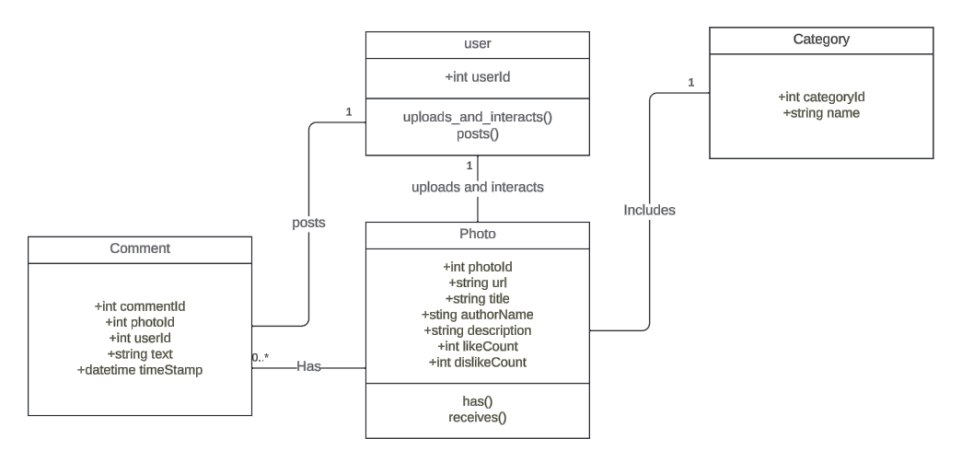
dESIGN
Notes:
Created a basic UML diagram of how the website should function.

Slide 5
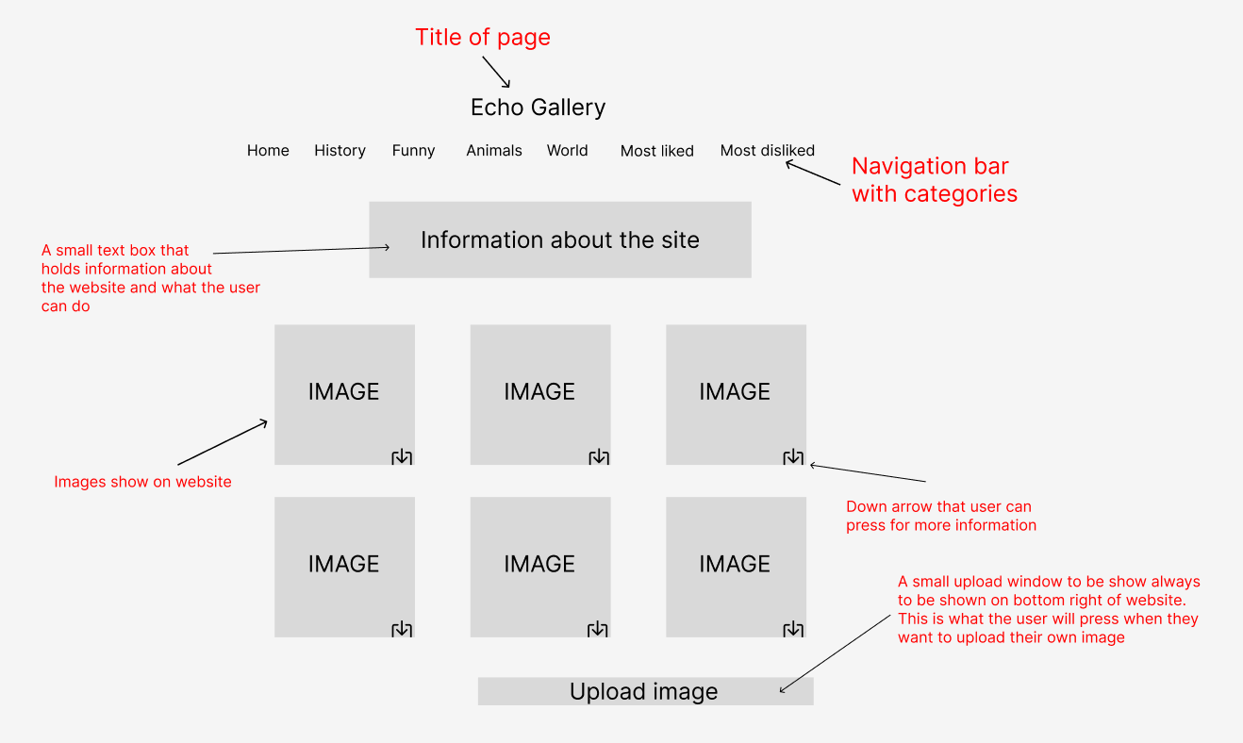
Notes:
Layout of the page

Slide 6
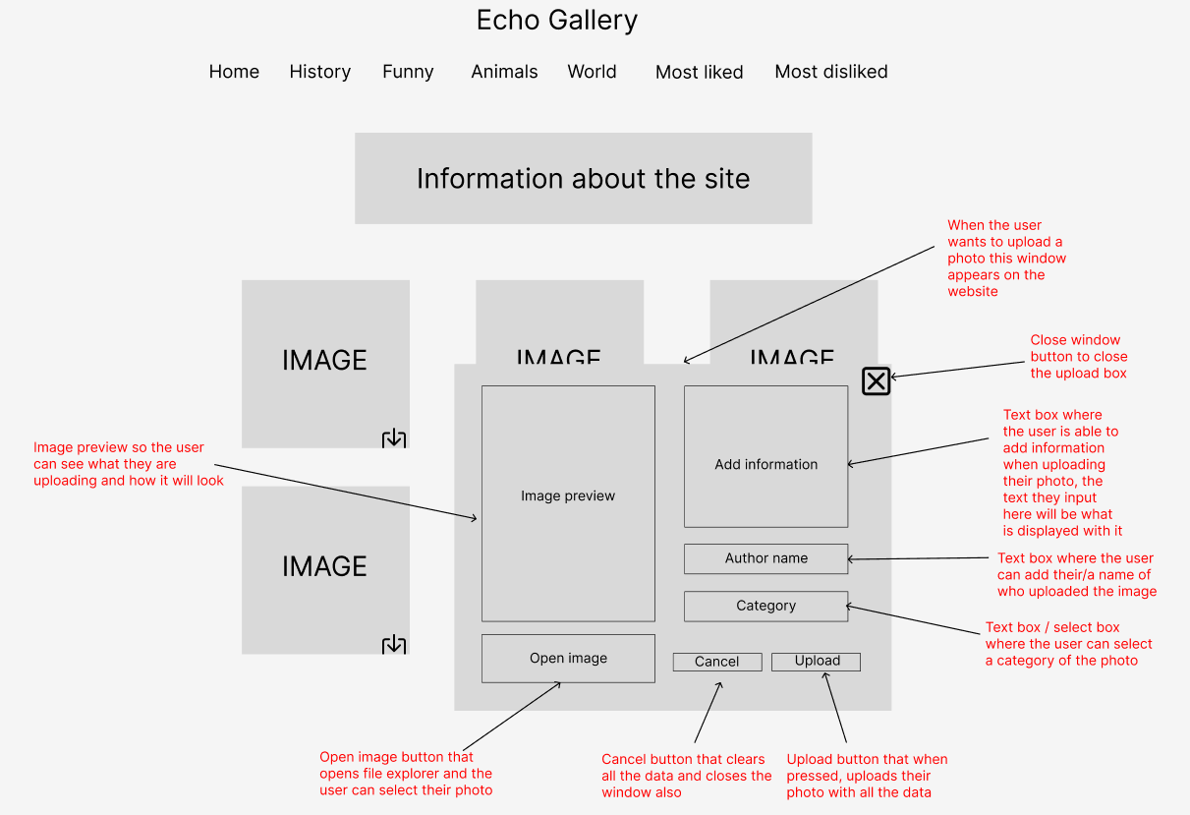
Notes:
Window where the user could upload their own image with context

Slide 7
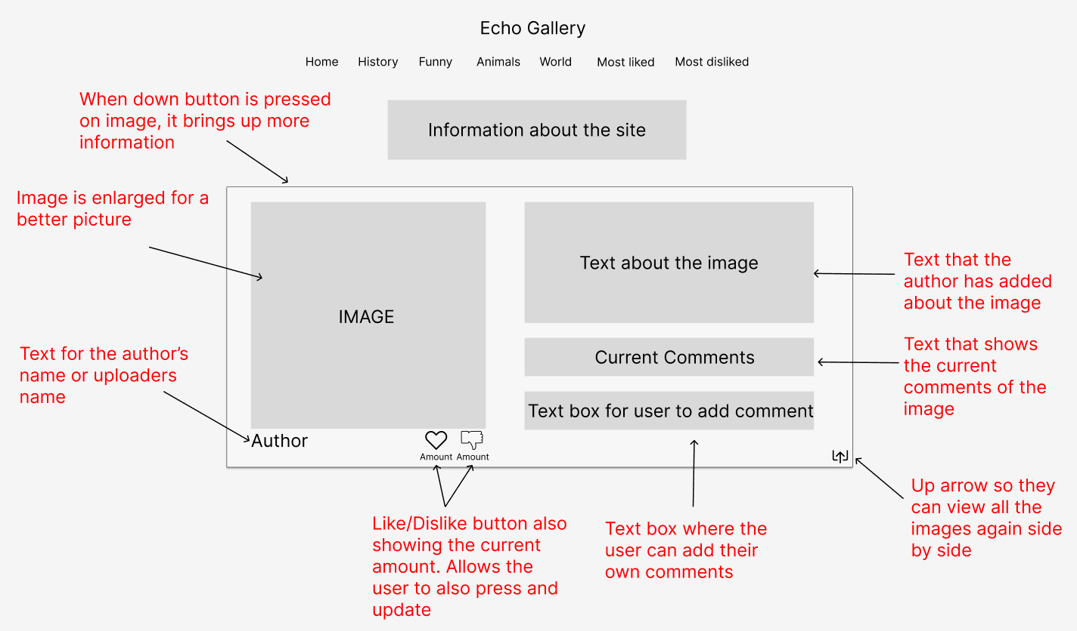
Notes:
Now looking at a deeper view on how the user will be able to view the information about images.
To show the information of the picture, you click a down arrow which extends the border to show the text.
As you can see the image would become in focus, and they will be able to see the textwhich holds the information about the image
Underneath that they will be able to see the current comments of the image
And below would be a textbox where they would be able to add their own comments
The user will also be able to like and dislike the image through this and also who uploaded the image

Slide 8
pLAN
Week | From | Description
1 | 22 Jan | Analysis – research information/photo upload based websites (e.g. Pinterest, Instagram)
2 | 29 Jan | Design – Final design choices of UI. Incorporate insights from analysis phase into practise
3 | 5 Feb | Sprint 1 – Pre-loaded images displayed in the UI and main body layout
5 | 12 Feb | Sprint 2 – Develop navigation bar
6 | 19 Feb | Sprint 3 – Add comment and like/dislike functionality
9 | 26 Feb | Sprint 4 – Upload image function and box
9 | 4 March | Sprint 5 - Implement when user uploads photo with comment/information and able to add name and theme
10 | 11 March | Sprint 6 – Implement when user uploads image it is displayed in main body with all details entered
11 | 18 March | Sprint 7 – Create a function that when clicked, it shows more information about the image instead of just image and text, giving a collage feel.
12 | 25 March | Sprint 8 – Finalise any GUI development. Get feedback from users to note any bugs or improvements that can be made
13 | 1 April | Sprint 9 – Final testing and resolve any bugs that may come up
14 | 8 April | Review and finalise project report
15 | 15 April | Final due diligence. Ensure everything is in order before the portfolio submission.
Portfolio due Thursday 18th of April
16 | 22 April | Revise and make notes of what went well along the way and what was difficult for presentation
17 | 29 April | Prepare for presentation
18 | 6 May | Presentation
Note:
Report will be updated when progress is made every week
Unit testing will be done throughout the project
Notes:
This is my plan
Phased Development: The plan follows a systematic approach, dividing the project into weekly sprints.
The project is UI focused. Emphasizing the design of the user interface early in the process demonstrates a user-centric approach
The plan shows a logical progression in feature development, from basic layout to more complex functionalities like commenting, liking/disliking, and image uploading.
I believe allocating time for gathering user feedback and conducting final testing before the final submission is crucial. This not only helps in identifying and fixing bugs but also ensures that the final product is polished and user-friendly.
The final weeks are dedicated to reviewing the project and preparing for the presentation, allowing for reflection on what worked well and what challenges I encountered.
Please note: Report will be updated when progress is made every week.
Unit testing will be done throughout the project

